Slide 1

Presents

Slide 2
Added this part for some reason. Second version, first version said “it’s true!” and I thought it was STUFU (David-SNUFU!!) so bye it goes
Presents

Slide 3


Song doesn’t really fit…
2005 spotco
Project Star
Part 1
-Start-

Slide 4




Slide 6



Ah yes… major text overhaul.
You’re under arrest, criminal.

Slide 7

What are you talking about? Me? A criminal? You’re fooling yourself.
Are you one of the corporation’s men?
Lol corporation…

Slide 8
Ha! You can’t fool me.
I was assigned to the important job of re-acquiring the corporation money you’re carrying.

Slide 9
I get it… you’re the assassin they’ve sent out to get me… and it appears you’re new to the business…

Slide 10


Changed some weird SK-200 name just to regular, all purpoise name
20
Anti-Force Bomb
25
-shot
Don’t underestimate me, to think you’re so good.
Shield Damage 9999

Slide 11

0
25
-shot

Slide 12

Don’t underestimate me!
ALL RET LASER 100%
RETURN FAST….
CHARGED<< FINAL
TARGET LOCKED
AWAITING IGNITION+
<<<IGNITION PROVIDED
AWAIT STANDBY<<<
FIRING<<<<
FIRING SOLUTION++YES
VERY, VERY, YES.
meh

Slide 13
Shield Damage 15
Double Laser
Take this!

Slide 14
0
25
Flare Cannon
-shot
Hull Damage 10

Slide 15

0
15
-shot

Slide 16
Shield damage 15
Double Laser

Slide 17
0
15
Flare cannon
-shot
Hull Damage 10

Slide 18

0
5
-shot

Slide 19
Shield Damage 15
Double Laser

Slide 20
0
5
Flare cannon
-shot
MISS

Slide 21

0
5
-shot
-missile
That was a close one… I better finish this quick.
A round of missiles will do him in.

Slide 22
Hull Damage 15
Double Laser

Slide 23
0
5
Flare cannon
-shot
-missile
Hull damage 10

Slide 24


Err…

Slide 26


Game Over
Press ESC to exit
You do not DESERVE a hidden secret!

Slide 27
Hull damage 45
SWE-IV Missile

Slide 30



I told you, I have nothing of the corporation’s, it just wanted me dead.
And you did it, nice job.
Ha ha... I guess that’s it for you, huh?
Surrender now, and you’ll live, at least to see another day.

Slide 31
Wait… what are you talking about you have no money…? Hold on a sec~!

Slide 33

I’ve failed… the money’s gone with him…
How will I ever explain this…
I guess I’d better return back home…
It’s all over for me…

Slide 34





`
-=Local map=-
(2.5 parsec radius)
In order to travel long distances, you need to launch from a Warp Gate.
There should be a Warp Gate around here…

Slide 35
Starport: galactic empires inspired.
-=Local map=-
(2.5 parsec radius)
**select destination

Slide 36
-=Local map=-
(2.5 parsec radius)
Planet** 7392-REN
-=info=-
*gas giant
*unexplored
**select destination

Slide 37
-=Local map=-
(2.5 parsec radius)
**select destination
Planet** 7393-REN
-=info=-
*oceanic/continental
*mapped

Slide 38
-=Local map=-
(2.5 parsec radius)
**select destination
Warp Gate **23431
-=info=-
*In service
*Food/lodgings
*Contact for destination & pricing info.
go to

Slide 39


Slide 41


Slide 42



Well, this is the warp gate.
What to do next?
-=option=-
-Land
-Continue

Slide 43


………..
-=option=-
-Land
-Continue

Slide 45
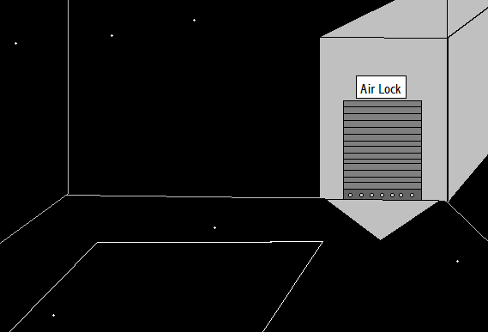


Slide 46
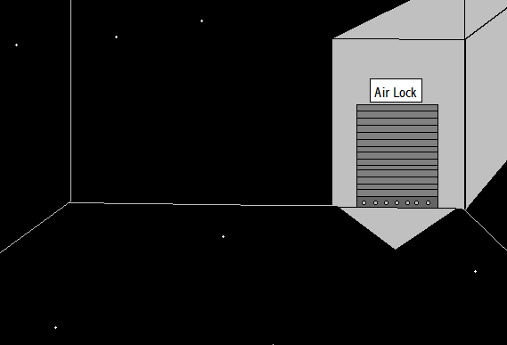

Slide 47
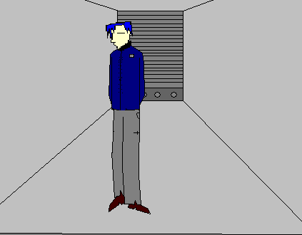

First time I drew a full body in this game. Art style changes, like

Slide 48
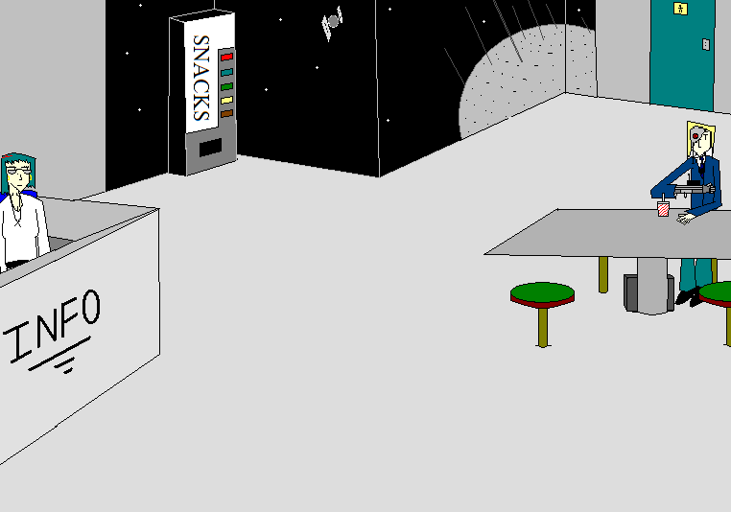

Auughhh… horrible glass effect now that I look back
Hmm… Nice crowd…
Now why’d I come here in the first place?

Slide 49
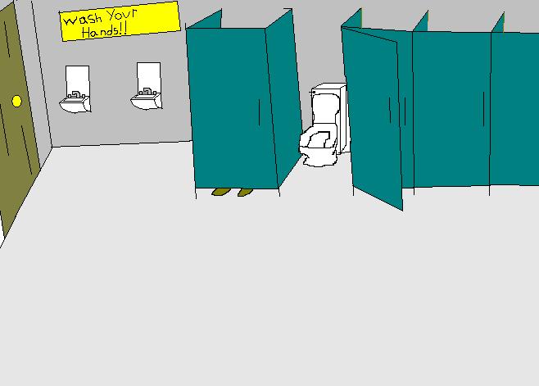

Slide 50
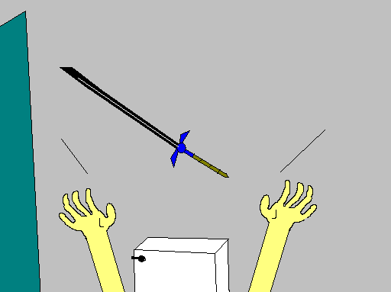
Got the Magic sword!
Special…
(Back)

Slide 51
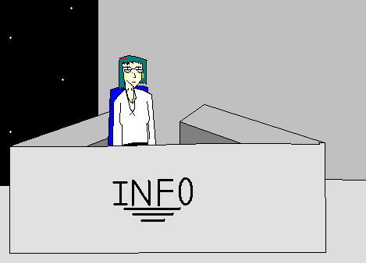



What is it…
Well, if you’d have my job, you’d probably be “frowning” too.
What’s with the frown?
No reason to be looking so mad.
Probably…

Slide 52

“Research…”
Stop staring at me…
-“Current News”
-“This warp gate”
-“Your Ship model”
-”How Ya doin’ baby?”
Back!!!

Slide 53
Don’t even try…
Back

Slide 54

Model: F-11Y
This is your ship?
It’s a standard model in bad condition.
Pretty pathetic.
Then again, knowing you, you couldn’t afford anything better…
Back

Slide 55
Hmm…
Legislature Debates,
Terrorism arrests,
Assassinations,
Every day life.
Stuff I know YOU wouldn’t care about.
Back

Slide 56
This old piece of orbiting crap is warp gate No.23431.
Stationed between 4 minor systems REN, WBL, UYO and GMY, there’s not to much too activity here, only about 100,000 travelers a year.
But hey, it’s all good to you, huh?
Back

Slide 58
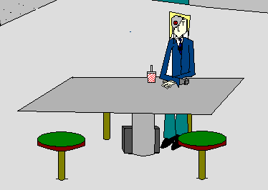
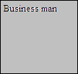

Yes, may I help you, sir?
Umm, no it’s allright…. Thank you for asking…
(Man.. This guy’s scary lookin’…)

Slide 60
InfoLAdy1.MainB

Slide 61
BUSI1.MainB

Slide 62
(As Second)
Yes, may I help you, sir?
Umm, no it’s allright…. Thank you for asking…
(Man.. This guy’s scary lookin’…)

Slide 63
ALL OUT Info then Busi

Slide 64
Info lady 2
What is it…
Well, if you’d have my job, you’d probably be “frowning” too.
What’s with the frown?
No reason to be looking so mad.
Probably…

Slide 65
“Research…”
Stop staring at me…
-“Current News”
-“This warp gate”
-“Your Ship model”
-”How Ya doin’ baby?”
Back!!!

Slide 66
Don’t even try…
Back

Slide 67
Model: F-11Y
This is your ship?
It’s a standard model in bad condition.
Pretty pathetic.
Then again, knowing you, you couldn’t afford anything better…
Back

Slide 68
Hmm…
Legislature Debates,
Terrorism arrests,
Assassinations,
Every day life.
Stuff I know YOU wouldn’t care about.
Back

Slide 69
This old piece of orbiting crap is warp gate No.23431.
Stationed between 4 minor systems REN, WBL, UYO and GMY, there’s not to much too activity here, only about 100,000 travelers a year.
But hey, it’s all good to you, huh?
Back

Slide 70
All out Busi then info

Slide 71
Allout Busi>info

Slide 72
Allout info>Busi

Slide 73
Repeat>Allout info>Busi
“Research…”
Stop staring at me…
-“Current News”
-“This warp gate”
-“Your Ship model”
-”How Ya doin’ baby?”
Back!!!

Slide 74
Don’t even try…
Back

Slide 75
Model: F-11Y
This is your ship?
It’s a standard model in bad condition.
Pretty pathetic.
Then again, knowing you, you couldn’t afford anything better…
Back

Slide 76
Hmm…
Legislature Debates,
Terrorism arrests,
Assassinations,
Every day life.
Stuff I know YOU wouldn’t care about.
Back

Slide 77
This old piece of orbiting crap is warp gate No.23431.
Stationed between 4 minor systems REN, WBL, UYO and GMY, there’s not to much too activity here, only about 100,000 travelers a year.
But hey, it’s all good to you, huh?
Back

Slide 78
EXIT

Slide 81
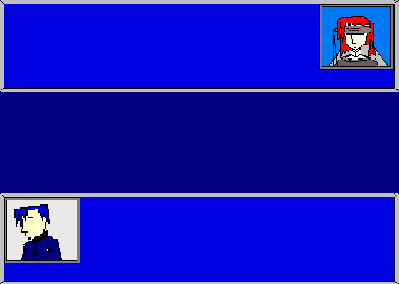
Operator #2386
**PLEASE TRANSMIT DESTINATION COORDINATES**
FACILITY Credits
XXXXXXXXXXXXXXXXXXX
LEAHIN Credits
2000
Leahin
Hmm? Oh, yah that. Now hold on a sec…

Slide 82
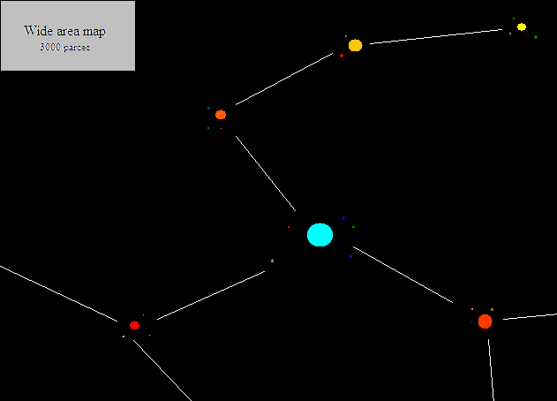
I need to return to system Quisti Vela VI. That shouldn’t be too hard to find, should it?
System Quisti Vela IV -=Click to Go to=-
System Quisti Vela V
(CURRENT LOCAL)
System Zeta Pasm II
-=Click to Go to=-
System Quisti Vela VI
-=Click to Go to=-

Slide 83
Not that one…
System Quisti Vela IV
-=Click to Go to=-
System Quisti Vela V
(CURRENT LOCAL)
System Zeta Pasm II
-=Click to Go to=-
System Quisti Vela VI
-=Click to Go to=-

Slide 84
Operator #2386
RECIEVED. TRIP WILL COST 750 CREDITS.
……………………..
FACILITY Credits
XXXXXXXXXXXXXXXXXXX
LEAHIN Credits
2000
Leahin
Yah, system Quisti Vela VI. Transmitting data.
Hold up… 750??? I should say that’s highway robbery!

Slide 85
Operator #2386
SIR, IT’S A STANDARD FARE…
FACILITY Credits
XXXXXXXXXXXXXXXXXXX
+750
-750
LEAHIN Credits
2000
1250
Leahin
Yah, yah, whatever. Just take it.

Slide 86
Operator #2386
WELL, SIR, ENJOY YOUR TRIP…
FACILITY Credits
XXXXXXXXXXXXXXXXXXX
LEAHIN Credits
1250
Leahin
Like that’s possible…

Slide 87


AAAAAAAAAAAAAAAAAAAAAAAAAAAAAAAAAAAAAAAAAAAAAAAAAAAAAAAAAA!!!!!!!!!!!!!!!!!!!!!!!!!!!!!!!!!!!!!!!!!!!
Well, here goes…

Slide 91


Slide 103



Slide 104
Okay… Well that was weird… as usual…

Slide 105
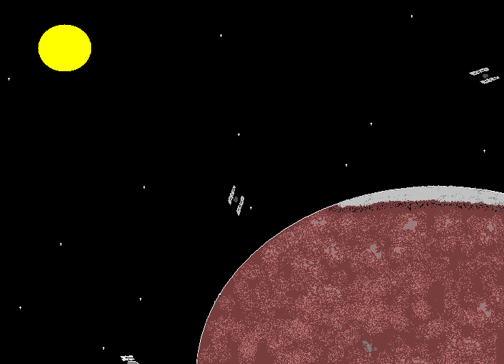
-=option=-
-Land

Slide 106
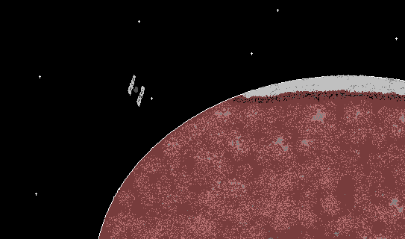


Slide 107


Slide 108
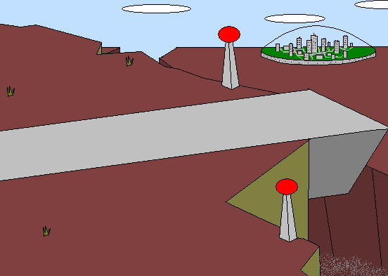


Slide 109
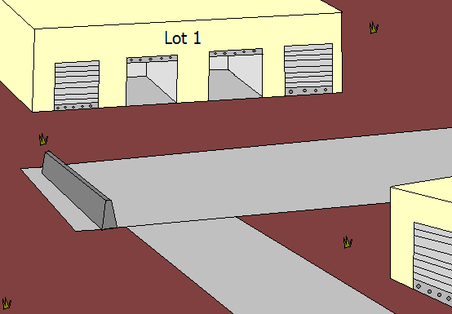



Slide 111
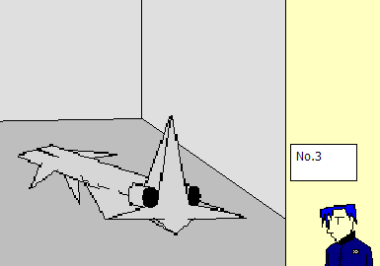

Slide 112
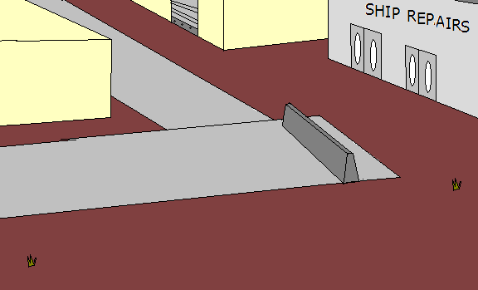

Before I go home, I need to get the ship repaired.

Slide 113
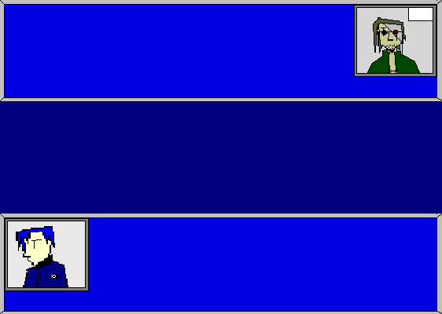
Mechanic
Again? Second time this week.
You must be getting into a lot of fights, huh?
Hey, dude. What do you need?
SHOP Credits
29500
LEAHIN Credits
1250
Leahin
Umm… an estimate on how much it’ll cost to repair my ship.
Just do it.

Slide 114
Mechanic
Allright, allright no problem.
SHOP Credits
29500
LEAHIN Credits
1250
Leahin
Just do it.

Slide 115
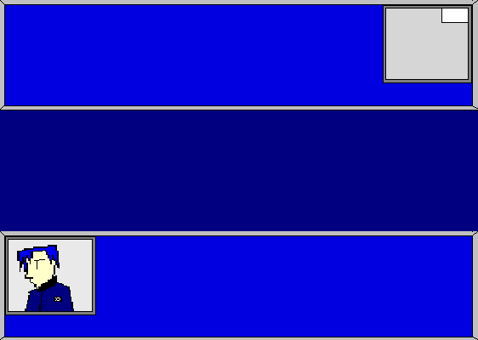
Mechanic
Allright, allright no problem.
SHOP Credits
29500
LEAHIN Credits
1250
Leahin
Just do it.
………………

Slide 116
Mechanic
Well, you can pay now, or you can pay after the job.
Hmm… It’ll be about… 1200 credits.
SHOP Credits
29500
+1200
30700
LEAHIN Credits
1250
-1200
50
Leahin
1200 credits????
I guess I’ll pay now…

Slide 117
Mechanic
Thanks, man. Come back in a day or so.
It’ll be done by tomorrow.
SHOP Credits
29500
30700
LEAHIN Credits
1250
50
Leahin
Yah. Take care.

Slide 118
I guess that’s everything here.
The cheapest way home is by train. The station’s just north from here.

Slide 119
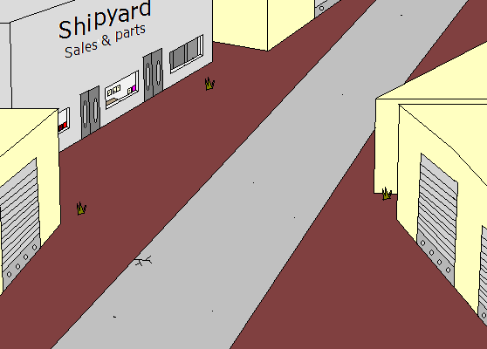

Slide 120
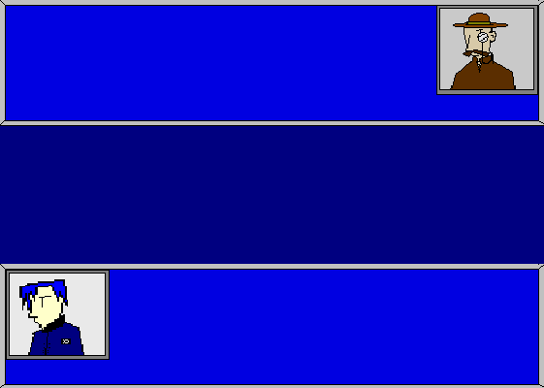
Shipyard Manager
Ah, yes, sir may I be of service?
SHOP Credits
29500
XXXXXXXXXXXXXXX
LEAHIN Credits
50
Leahin
I’m.. I’m just looking.

Slide 121




<- EXIT
We have a very nice selection here, If I should say so myself. But nothing too special, though.
Yawn… This cowboy/detective outfit is hideous.
LEAHIN Credits
50
Sell
Buy
AR2—model3089
An economic model not meant for major combat. Medium sized storage bays & lowest possible fuel consumption.
M450 Cannon
Add-on available to most small to medium sized ships.
Launches explosive shots for medium damage.
Shld- 5
Hull- 10
6000 credits
1500 credits
2XII-model2.5
A model made for mainly merchants. Large storage bays. Oh, and good hull strength too. Other than that pretty wimpy.
WI-MP
Using the latest advancements in technology, this small attachment doubles the shield output.
Shld- 15
Hull- 45
15000 credits
2000 credits
MGA.FUC© boosters
Attachments to both sides of any ship. Significantly improves speed and handling of a ship. Very “pimp”.
SWE-IV Missile
Attachment that launches missiles. Takes time to charge.
1200 credits
1000 credits

Slide 122
<- EXIT
We have a very nice selection here, If I should say so myself. But nothing too special, though.
LEAHIN Credits
50
Sell
Buy
AR2—model3089
An economic model not meant for major combat. Medium sized storage bays & lowest possible fuel consumption.
M450 Cannon
Add-on available to most small to medium sized ships.
Launches explosive shots for medium damage.
Shld- 5
Hull- 10
6000 credits
1500 credits
2XII-model2.5
A model made for mainly merchants. Large storage bays. Oh, and good hull strength too. Other than that pretty wimpy.
WI-MP
Using the latest advancements in technology, this small attachment doubles the shield output.
Shld- 45
Hull- 15
15000 credits
2000 credits
MGA.FUC© boosters
Attachments to both sides of any ship. Significantly improves speed and handling of a ship. Very “pimp”.
Are you kidding?? I don’t have the money to get that.
SWE-IV Missile
Attachment that launches missiles. Takes time to charge.
1200 credits
1000 credits

Slide 124
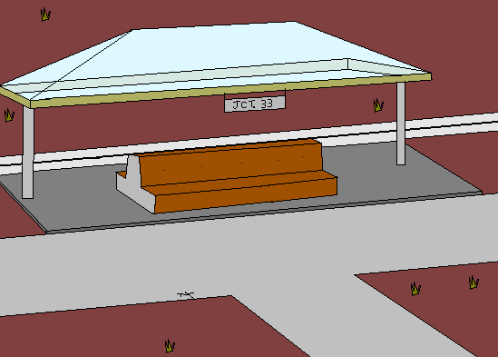

Slide 125
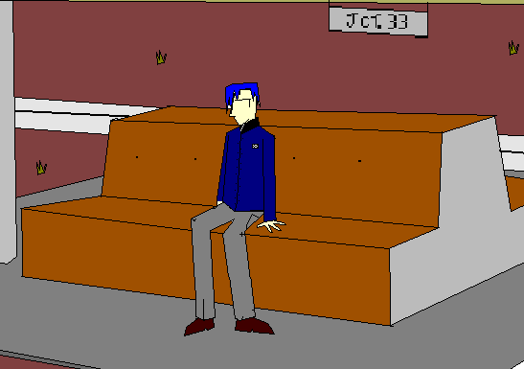

Secret message!!
Yah baby!
This is the first time I ever
Drew the Leahin without using the original radio menu picture as the head!
100% freehand, baby!
I’d say it looks pretty good, huh?
………………..
Oh… Caina…it’s you… Why are you here?
Hey! Leahin! You’re back!

Slide 126
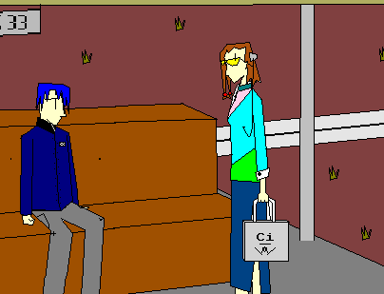

Just…
Forget I said it.
Any reason I can’t be here? I was just out shopping and I just decided to stop by…
Hmmph… Whatever.

Slide 127
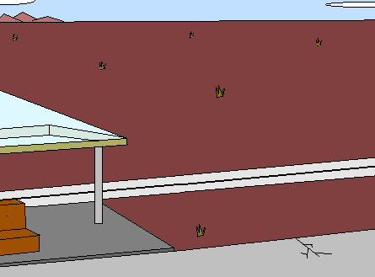


Slide 128
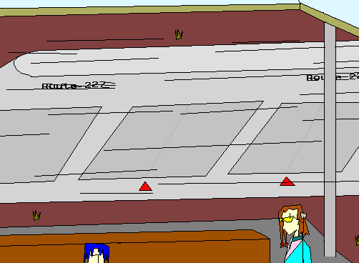

Slide 129
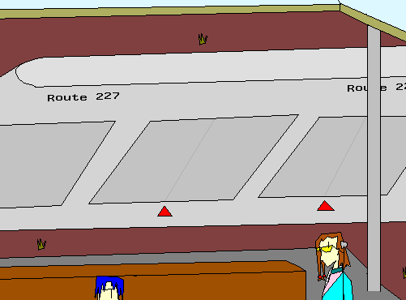
Secret message!!
lol this train animation is sadly pathetic…

Slide 130
It’s here! Come on, Leahin, lets go!

Slide 131
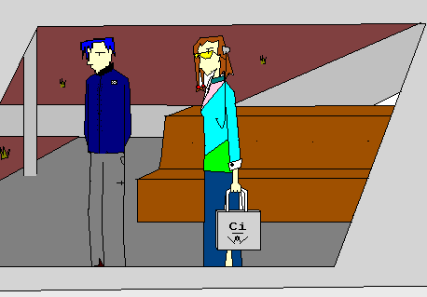

Slide 132
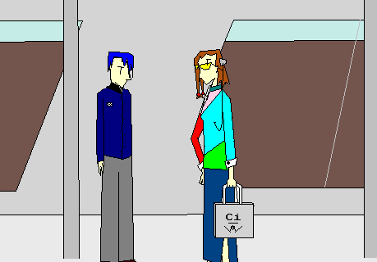
You’ve been acting all depressed…
What happened?
I’m just wondering… what’s wrong?
What?
Oh…. Nothing.

Slide 133
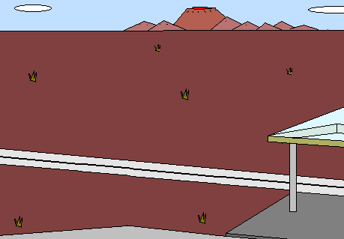


Slide 134


Slide 135
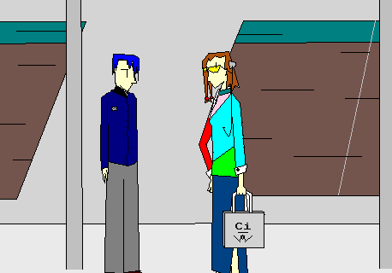
So, how’d it go?
So, that means that they’ll leave…
That’s great! I guess you’re safe now, huh?
Hmm… the mission?
Oh, allright I guess.
Hmm… I guess…
…….
Lol foreshadowing

Slide 136



Slide 138
Oh, this? Um… Some stuff…
Ohh.. Not for a while, I think.
Maybe a month or so.
Sorry.
C’mon, don’t be like that…
Oh, umm.. I’m leaving on a trip tomorrow.
Some stuff for what?
So, what’d you buy?
Really? And when will you be back?
It doesn’t really matter, I’m probably not gonna be around here for long…

Slide 139
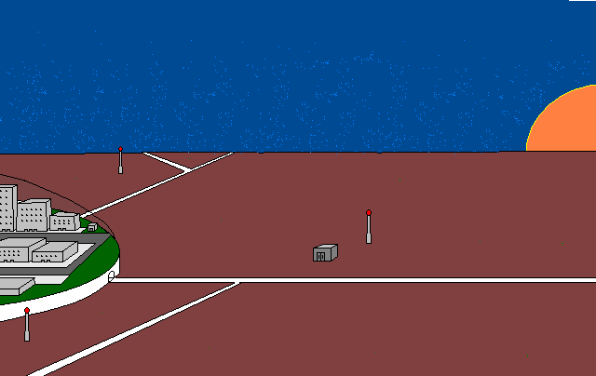

Slide 140
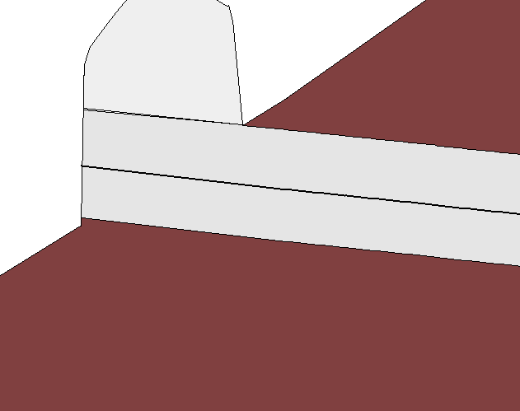


Slide 141

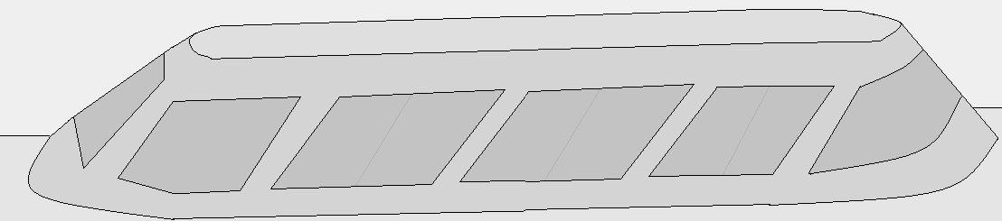

Slide 142
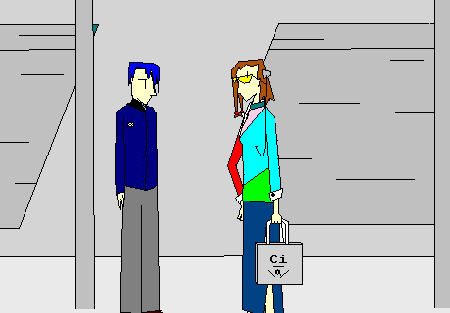
This is your stop, right?
Then I guess I’ll be seeing you later. Call if you need me.
It is.

Slide 143
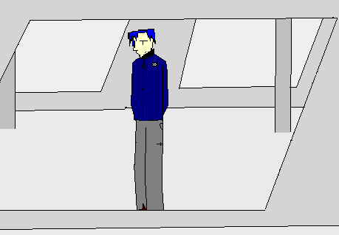

Slide 144
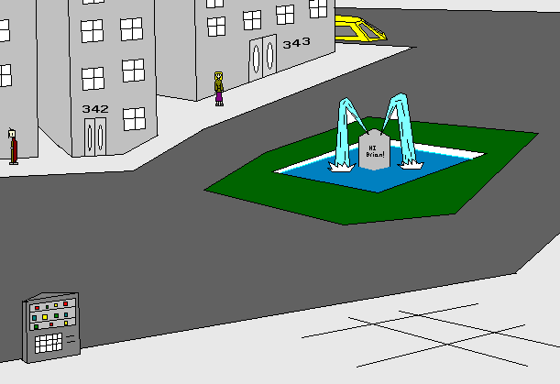
Building 342…
Before I go back, I better get some rest…

Slide 145
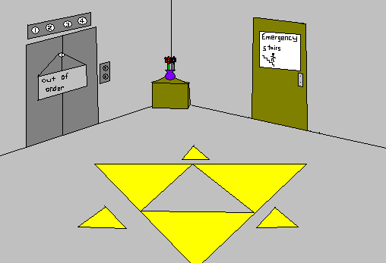

Slide 146
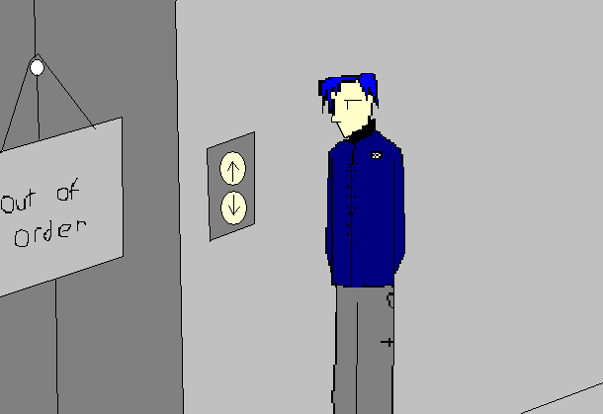
Out of order… I’ll have to use the emergency stairs.

Slide 148
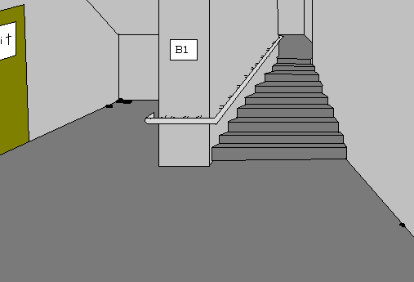

Slide 149
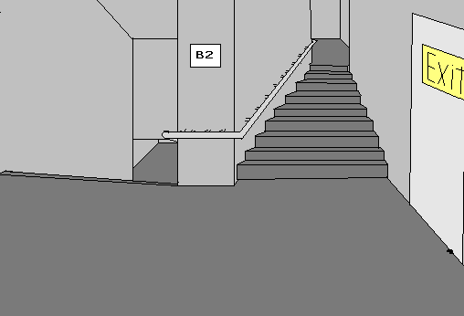

Slide 150


Slide 151
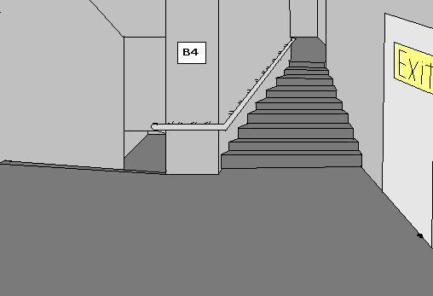

Slide 152

This is the floor.

Slide 153
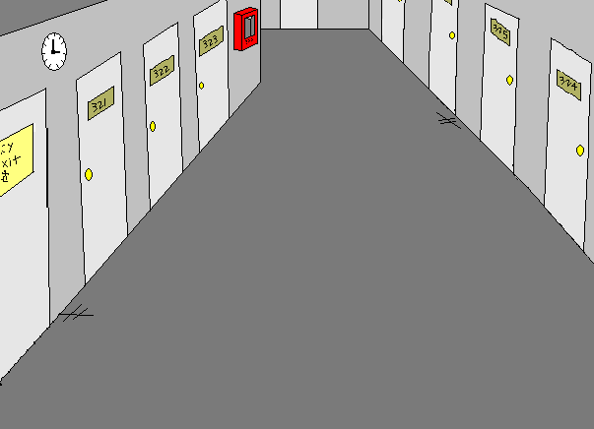
Room 323…

Slide 154
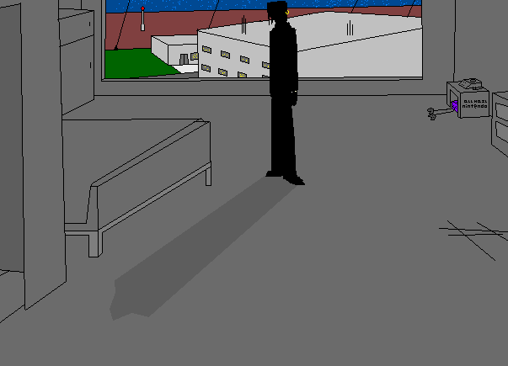

!!!!
Someone's here!!

Slide 155
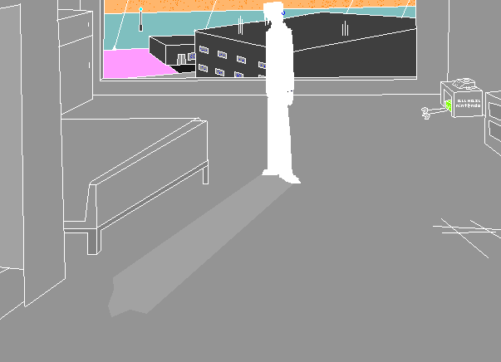

Someone's here!!

Slide 156
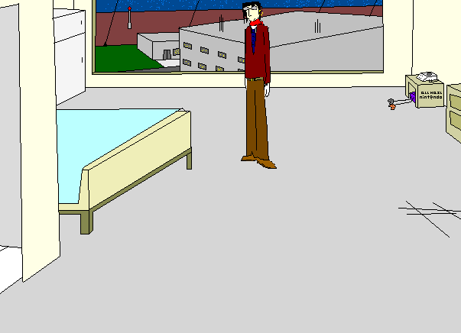
Someone's here!!

Slide 157

I guess I can assume you know why I’m here. Sit down, and maybe we can have a chat.
It you!

Slide 158

All your base are belong to us! HAhAHa! Leahin said “IT YOU!” I did it on purpose! You actually thought I was capable of making grammar errors???
What? You don’t get the joke?
Well, if you were you’d get it…
-Shiny
Spencer
BACK

Slide 159
OH SCHNAPPS
YOU FREEZE THE GAME

Slide 160
OH SCHNAPPS
YOU FREEZE THE GAME

Slide 161
OH SCHNAPPS
YOU FREEZE THE GAME

Slide 162
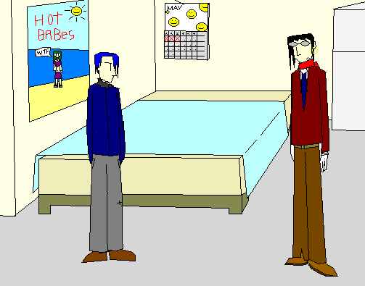
HAhAHa… the corporation never really expected any better from you.
We just sent you out to do the work nobody else wanted to do. We just wanted him dead.
It was all set up.
It was just a test of your skill.
We were all just thinking that if you could never pay, you could work for us from now on.
Same opinion on our side.
We just think you aren’t cut out for work in our business.
……….
Because you’re back.
What’s that supposed to mean?
It means that you failed that mission.
You know what I’m talking about.
…what?
……
Why are you here?
What?... Oh… man…
What… What do you mean?
Ha ha… work for you… that’s a dead-end job…
And then you’ll leave me alone?
That’s a thought.
Now that wouldn’t be the way we operate around here, wouldn’t it?

Slide 163
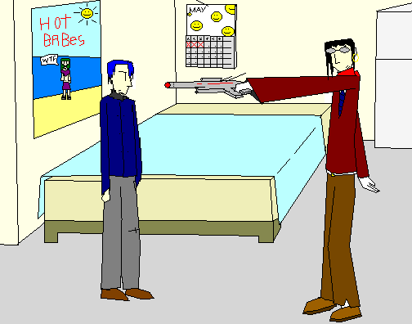
Hands up.. You’re coming with me.

Slide 164
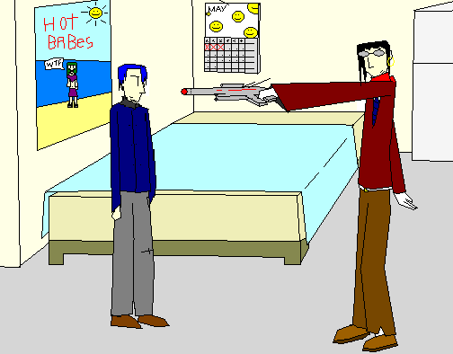
Hands up.. You’re coming with me.
Heh heh… A gun. You sure came prepared.

Slide 165

Don’t be a smart-a**.
Heh heh… A gun. You sure came prepared.

Slide 166
Options
-Punch him
-Insult
(oh man.. What do I do….)

Slide 167
Insult
Pathetic last words. Don’t get me angry.
Heh…
You sure got the look goin’ for ya…
A suit… round glasses.. Even a tie! Evil corporate agent.. Nice style.
(…….. That sure got nowhere fast.)

Slide 168
Menu after Insult
Options
-Punch him
-Insult Again..?

Slide 169
Insult twice-Gonna die!!!
……….
Okay,.. You know what? I’ve had enough of . Shut Up for Good!!
Heh.. Lame story there. “It was just all a test of your skill.” Sounds like a wanna-be Neon Genesis Evangelion style plot twist there…
Wait..

Slide 170
Okay,.. You know what? I’ve had enough of . Shut Up for Good!!
Wait..

Slide 172
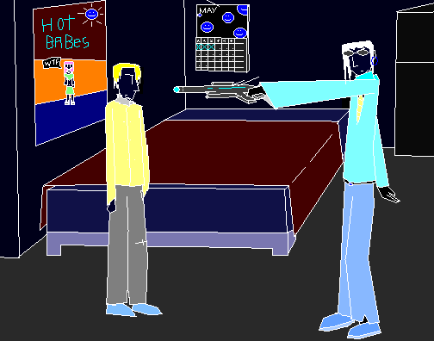

Slide 173


Slide 174
Game Over
Press ESC to exit
Full of vexation come I, with complaint against my child, my daughter Hermia.

Slide 175

Punch!!

Slide 176

HAH!!

Slide 177


Slide 178


Slide 179

You…..

Slide 180

(that punch animation was pretty awesome, eh?)
Options
-Ask Questions…
-Grab The Gun!!
Heh.. That worked out nice.
Now I should…

Slide 181

Ask questions. Stufu. Or David style, SNUFU!!
Now tell me… What was that you were talking about…. A test? Why are you here?
(Crap…Didn’t think he’d answer.)
…

Slide 182

Options
-Grab The Gun!!

Slide 183

Yay Grab the gun.

Slide 184

Ha…Who’s The Man Now, Dog?
Now tell me… Why are you here? What do you want?
Wait.. What? You’re not in the position to be making the decisions here…
…….
It’s about time I leave.
http://www.ytmnd.com/

Slide 185

Uhh… what are you trying to do…?
HAhAHa!! Watch this!

Slide 186

Wait.. You’re not gonna jump…are you….
HAhAHa!! Watch this!
Exactly. Don’t think it’s over… I’ll be back. Later.

Slide 187


Slide 188


LOL that turned out funnier than expected.

Slide 189

!!!!!

Slide 190

!!!!!
Did he just do that….?
That’s a pretty long fall…

Slide 191

That’s at least 5 stories…
I doubt anyone could of survived that…

Slide 192
Is he dead… Is it all over?
…He said he would be coming back…and if not him, someone else…
I should leave… They could come back any time… I need a place to stay, at least overnight.. but where…?

Slide 193


I need somewhere to stay… Not here, though I’m sure they’ll be coming back…
Where though… Let me think…

Slide 194


Slide 197

That’s it! I know, I can stay at Caina’s place!
The trains are closed now… Maybe I could go there on a Taxi…

Slide 198

I need somewhere to stay… Not here, though I’m sure they’ll be coming back…
Where though… Let me think…

Slide 199


Slide 200


Slide 201

Auto-Taxi system…? Never used one of these before…

Slide 202




Of course, sir.
*ZZT*…*ZZZT*… This is system Quisti Vela VI galactic Taxi service… model 3X Hovercraft… How may I be of service...?
Err… Show a map of the surrounding area… Can you do that?

Slide 203

City no.90
City no.87
Starship landing zone
City no.86
(you are here)
I know Caina lives near City 87…

Slide 204
Yay the big 202. This game has now officially grown larger than goblinsRPG3. 8/19/2005
Of course. Now, can you pay the 50 credits it’ll cost?
Err…Take me to City 87.
50 credits…? I’ve got exactly that much.

Slide 205

Operator
Umm… Yes, like that.
FACILITY Credits
XXXXXXXXXXXXXXXXXXX
+50
-50
LEAHIN Credits
50
0
Leahin
Err… I just slide it down this slot… right?

Slide 206
Operator
It is. Please have a seat, sir. The car will start moving shortly.
FACILITY Credits
XXXXXXXXXXXXXXXXXXX
LEAHIN Credits
50
0
Leahin
Is… that it?

Slide 208




Slide 209


Slide 210
“Later..”

Slide 211


I guess… If you must know… I’m just doing this part time… To earn money for college.
Err… I’m allright I guess…
Why’d you ask?
It’s not far now.
Why are you asking so many personal questions… What are you trying to suggest?
Heh… I wanted to be a Journalist. Ever since I was young…
…Thanks. We’ve arrived at Citydome 87. It was nice meeting you.
Err… Well good luck to you, I guess.
………………….
…… So, how are you doing? Everything allright in your life?
So, how do you like your job?
N-Nothing… I was just wondering… It’s just that there’s nothing to do…
I dunno… Just that I’m bored…
How far are we, anyway?
…………….
College? What are you gonna do there?

Slide 212


Slide 213

Oh wow that worked out nice.

Slide 214



Slide 215


Slide 216

Oh.. Man…I forgot… I don’t even know where Caina lives…

Slide 217
Oh.. Man…I forgot… I don’t even know where Caina lives…
She has to be somewhere… Maybe someone around here knows her…

Slide 218

Inside the convention center…

Slide 219
Fish!!
Oh wow… Fish…

Slide 220

Like, actually inside

Slide 221

Try the elevator.
Err… Do you have an appointment…?
You need to sign in here…

Slide 222

Free Food!!!
Free food… I am pretty hungry…

Slide 223

Err… Welcome. Um… Do you have any Business here…?
Oh.. Then please leave. Sorry.
Oh.. Umm… not really.

Slide 224
Maybe somewhere else…

Slide 225

Yay finally leave.

Slide 226


Slide 227

Caina!!

Slide 228

Huh…? Who is it?
Caina!!

Slide 229

Huh…? Who is it?
Hey, I’ve been looking for you…
Caina!!

Slide 230

Huh…? Who is it?
Oh… Leahin… It’s you. What are you doing here…?
Hey, I’ve been looking for you…
Caina!!

Slide 231

Huh…? Who is it?
…What? Stay at my house? Like a sleepover? What are you talking about?
Oh… Leahin… It’s you. What are you doing here…?
Um… I’m just wondering… Why? You came all the way here for a place to stay? What’s wrong with your apartment?
The corporation? I thought you settled it with them.
You lied? What would you do that for?
You didn’t want me to worry…? Why did that matter?
It’s allright… I don’t really care.
And you can stay, if you really want. You’re always welcome.
Here, sit down.
I… well… I don’t know. I just wasn’t thinking.
Sorry…
Really?
…Thanks.
Hey, I’ve been looking for you…
No… Just until tomorrow… I just need a place to stay…
Heh… to tell you the truth, I just need somewhere to hide. The corporation is after me.
…I lied. They weren’t even after the money, just the work I could do for them.
Well, because I didn’t want you to worry. And I thought things wouldn’t turn out like this.
Oh, Err… I was visiting…
And I need to ask, can I stay at your house for a while?
Caina!!

Slide 232

You’re leaving… well, It was bound to happen eventually.
You travel a lot for your job, right?
Wait… What? You’re leaving forever?
Well, okay…
We’ll keep in touch and still be friends, right?
Well… are you gonna finish your meal?
Thinking what?
Oh.. Yes, I do.
Yeah… and probably never coming back.
I’ll sure miss this place...
…Hmm? Oh, sorry…
It’s just I was thinking…
It’s the trip tomorrow…
This is probably the last time I’ll ever be here…

Slide 233

Well, okay…
We’ll keep in touch and still be friends, right?
Oh.. Yes, I do.
Of course.

Slide 234
Your arm… I never noticed it before…
You always wore a glove over it…
Of course.

Slide 235

All right…
Your arm… I never noticed it before…
You always wore a glove over it…
…Yah…
My arm… you mean this?
And you’re wondering how I got it?
It’s from a long time ago…
It… It doesn’t matter now.
You know what..? I’m not really hungry. I’m finished, lets go.

Slide 236

Yu-gi-oh!!
Come on… we’re leaving.
Don’t worry about the trash… They’ll clean it up.

Slide 237

Look familiar?

Slide 238

You don’t know where I live, right?
Then follow me.

Slide 240


Slide 241

Lol… unnecessary character development!
Well, I haven’t slept for days…
I guess I am.
Well, I am.
You guess?
It’s in here.
Come inside, You’re tired, right?
Allright, let’s go.

Slide 242


Slide 243

Over here!

Slide 244

Over here!

Slide 245

Over here!

Slide 246

Come on, hurry up!
Over here!
Admiring my beautiful form, are you?

Slide 247


Slide 248


Slide 249

PURE AWESOMENESS!

Slide 251


Slide 252

Over here.

Slide 253

Over here.

Slide 255


Slide 256


Slide 257

So, this is your apartment…?
Not really what I expected…
Yeah… That would be it…
Ha ha… wait around while you take a shower?
I’m pretty good at that…
Well… You can enjoy it to the fullest extent.
I’ve got to take a shower. If you really want, there’s some magazines lying around… read those.
Nothing… Never mind…
Forget I said it…
And you’re implying that….
Not what you expected?
Why? …Because It’s so messy?

Slide 259

I’m gonna take a shower… don’t try anything messed up, okay?
If you really want something to do, read some of the magazines lying around.

Slide 260

Yes it was.
Leave me alone.
That was not funny.

Slide 261
Lol aftertime
If you really want something to do, read some of the magazines lying around.
And leave me alone, seriously.

Slide 262
Do you want me to friggin’ rip your head off??
LEAVE ME THE HECK ALONE!!

Slide 263
If you really want something to do, read some of the magazines lying around.
And leave me alone, seriously.

Slide 264

If you really want something to do, read some of the magazines lying around.
And leave me alone, seriously.
I’d rather not… She’ll probably take up that threat.

Slide 265


Slide 266



HEADLINE!! Studies Show you should exercise.
Darn strait, it’s true! Well, this is filler space so I have to make up some sort filler for the headline and articles. And here’s some random Picture!!1!
Don’t Run With Scissors!!!
Seriously. Dude if u fell, u would like die or something. Don’t do it. Seriously.
For real.
Yah…. Lots of filler mnn hnn.
This is gonna take me a while.
Well you should exercise. Mr. T agrees, right?
He’s cool. For some reason I keep putting him in the game.
Moms, Tell your Kids To stay away from this guy.
Darn he is scary.
Like ur mom sez, you should excersize somewhat every day until you die of starvation.
Can YOU help me make up this filler?
Oh rly you sez?
Yah rly I sez bak.
Why don’t you just ignore all this pointless filler and continue with ur life?
I already lost mine…
*Peace Out*
Plz? This is taking too long and is boring.
Well at least pretend you’re reading a real magazine, rright? Well only a few more lines to go… auughhh so close yet so far. MUST CONTINUE… ON….. POWER…. LEAVING….
I r bored!
Hey, well I am…
Gimme a break.

Slide 267
What kind of crap magazine is this…?

Slide 268
(first page)
HEADLINE!! Studies Show you should exercise.
Darn strait, it’s true! Well, this is filler space so I have to make up some sort filler for the headline and articles. And here’s some random Picture!!1!
Don’t Run With Scissors!!!
Seriously. Dude if u fell, u would like die or something. Don’t do it. Seriously.
For real.
Yah…. Lots of filler mnn hnn.
This is gonna take me a while.
Well you should exercise. Mr. T agrees, right?
He’s cool. For some reason I keep putting him in the game.
Moms, Tell your Kids To stay away from this guy.
Darn he is scary.
Like ur mom sez, you should excersize somewhat every day until you die of starvation.
Can YOU help me make up this filler?
Oh rly you sez?
Yah rly I sez bak.
Why don’t you just ignore all this pointless filler and continue with ur life?
I already lost mine…
*Peace Out*
Plz? This is taking too long and is boring.
Well at least pretend you’re reading a real magazine, rright? Well only a few more lines to go… auughhh so close yet so far. MUST CONTINUE… ON….. POWER…. LEAVING….
I r bored!
Hey, well I am…
Gimme a break.

Slide 269

Cover. A little weak.
Issue twenty-somethingth
SPOTCO
-Weekly Magazine-
This week, We Interview random people!
And plus,
Where do babies come from? Do you know? Do you really want to know?
Find Out!

Slide 270





2nd page.
TOP STORY!
Are you having fun?
Help me conquer my greatest insecurities and send me feedback at
mootothemax@gmail.com. Plz or I will li3k die of shame.
As addressed in the cover,
Where do Babies come from?
After doing headlong research (and we mean RESEARCH!!!) we still don’t really kown. Probably Mr. stork or something. If Disney sez so, then I KOWN IT BE TRUE!
And that brings us to our deeper topic, why are there so many ff7 fanboys? I mean SERIOUSLY it wasn’t THAT good. Yah it was good but it was not TEH BEST GMAE EV3R!!!
Where do babies come from? Well, apparently for this one, the ghetto. The rich, white country club ghetto that is.
Could you say “no” to a face like this?
Advertissme
We wanna know. For personal reasons. Enter in our latest poll and let us see.
P.S. Pugs PWN
BILLY: PLEASE REPORT TO TEH OFFICE; UR MOM IS LOOKING FOR U.

Slide 271


Last actual page
Them peoples won’t leave me alone!
Here we interview random people, as advertised in teh cover.
(us): So how are you today?
POO: What? Who are you?
BUT: Yah seriously leave us alone.
MOM: Would this happen to be one of them candid camera taped reviews?
(us): Kinda… If u look at it that way…
BUT: wait… are our names being made into hilarious acronyms?
(us): Kinda…
POO: Leave us the F&%$ alone.
So there you have it. – success!
Yahoo! I’m-a almost done wit this magazine!
Darn you must agree making a magazine full of filler is hecka annoying, yet I somehow did it! I hope you enjoyed it more than I did! I doubt anyone actually read all the articles! Ah well!
You think this is amazing for a PowerPoint gmae?
I have not yet even begun to even barely tap the whole power. See, there's gif’s like on the left… could do some cool stuff with that… and putting 3d backgrounds…I tried some of that and there’s adding movies. In theory one could like add fmv’s like in final fantasy! Wow im not that skilled.
With Sweet Mercy!
It’s like teh magicks!
And we have Just enuf time for VIEWER MALE!
Today;z viewer male is from Katie Q., a shemale from Renton, the land of heretics.
Katie Q. asks: “Why is this magazine so darned mess-ed up-ed in the head-ed?”
Well, Katie, you see, we have to be messed up and not make any sense because this is a FILLER MAGASIN for the game PROJECTSTAR. I just wanted to get this done fast so I can get to the kissy part. (not really)
Allright, that make sense? Well, that’s all of SPOTCO weekly magazine for this week.
In truth, I might make another one if enuf people play this game I dunno.
French
Will The Real Slim Shady Please Report To The Principal’s Office

Slide 272




(More ads)
Free Candy for little kids!
Just step inside the van!
Back page. Puttin’ I an Advertissme later here, rright?
Do you like puppies?
Puppies are cute.
Spotco Inc.
Leading teh way with groundbreaking, innovative software for the PowerPoint platform
Your Subscription has expired. Call ur mom
(Close)

Slide 273
Shameless waste of time eh? Ahahhahahahhahahahaha…. I dunno.

Slide 274

That was…dumb…

Slide 275

That was…dumb…

Slide 276

Well now… having fun?
…Whatever.
That was…dumb…
How can you read these magazines? They’re just so… dumb.

Slide 278

I guess…
Good night.
Somewhere nice and warm.
Preferably.
They won’t.
I don’t know… probably leave this planet…live somewhere else.
Well, Leahin… I was just wondering… what are you going to do now?
Well… good night. For the last time, probably.
Live somewhere else? Do you have any idea where?
The corporation… won’t they find you?
So… you’ve got everything all nice and planned out?

Slide 279
Well, Leahin… I was just wondering… what are you going to do now?
Well… good night. For the last time, probably.
Live somewhere else? Do you have any idea where?
The corporation… won’t they find you?
So… you’ve got everything all nice and planned out?

Slide 281


Slide 284


Slide 285
Cinematic effect??
(The next morning)

Slide 286

Sup dudes. 12/28/05

Slide 287


Slide 288


Slide 289


Slide 290


Slide 291


Slide 292


Slide 293

If you’ve ever noticed, I used to re-draw every character almost every scene. Now, that I got Photoshop I just keep on reusing the same sprites.
Lol?
1/9/06 didn’t work on much…
So… This is it…

Slide 294

I was just joking…
Well, wherever you’re going, good luck and don’t like… die… you know?
So… This is it…
Why say that?
This is probably the last I’ll ever see of you, right?
That’s probably not the best idea…
You’re running away… Now you’re at their mercy. You need to stand up and fight back!

Slide 295

I was just joking…
Well, wherever you’re going, good luck and don’t like… die… you know?
That’s probably not the best idea…
I won’t, I won’t. Don’t worry about it.
And wherever you’re going… good luck with whatever.
Thanks… means a lot from you…
…Later.
Bye.

Slide 296


Slide 297


Slide 301


Slide 302


Slide 303


Omg just look at that GIF technology, like mentioned in the magazine!
I should a done this earlier! This would have been hecka tough if I didn’t do the gif.
If u think this is cool, wait and see what I have in store for you in a few slides.

Slide 305

…hello?
…What about it?
Yeah I’m coming…
You’ve got business to attend to?
Oh, Diamv it’s you…
I’ll be there. Bye.

Slide 306



Slide 308






Yay more gif’s like I said. This is gonna be cool.
Err… I landed on grass and only sustained minor injuries…
HAhAHa! It’s me! Not expecting that, were you?
That’s strange… somebody’s following me…
Show yourself!
Urk…
OMGLOL WTF
Aren’t you supposed to be dead? Like, a five-story building and all…
Oh… I see… Everything all makes sense now…
**SARCASM**

Slide 309
Err… I landed on grass and only sustained minor injuries…
HAhAHa… Tis’ not reason of myself. I just do as told, see?
Ah, yes, for the decision has already been made!
Why do you keep following me... Why do you want me dead?
……..
Must we fight, here and now?
Oh… I see… Everything all makes sense now…
**SARCASM**

Slide 310




You thought I was gonna let you off without at least another battle?
I won’t be fighting you this time…
Though I do have something just as good to take my place…
20
25
Activating Force Field…
-Shot
Hey! Come back here!
What the crap is this thing?

Slide 311
TEXT PROMPT!
Yay TEXT PROMPT!
I HEARTS THE TEXT
PROMPT BECAUSE THIS
IS TEH FILLER TEXT…
MEH WHAT DO YOU
EXPECT FOR ME TO SAY?
RANDOM JARGON, LOL.

Slide 312


Jan.24.06
A gif background…trying something new… I hope It won’t lag…
20
10
25
GOBLINs-3type missile
-Shot
Shield Damage 0
Double Laser
Shield damage 10
It’s no good… the thing’s invulnerable!

Slide 313

After first round of firing…
10
0
25
GOBLINs-3type missile
-Shot
Shield Damage 0
Double Laser
Shield damage 10
Had to include some sort of last secret…
So like yah, how’re you doing?
Having fun? Has the music looped yet? Did you really find this in-game or just scrolling through the PowerPoint show? Lol.
Nope… It’s taken no damage at all…
It must be because of that force field!
A long pause of indecisiveness…
Planning the battle strategy, are we?

Slide 314

Beginning self-destruct process… not gonna be fun… Stupid un-linearity… just more work for me… and there’s setting the music, on 3-diffirent branching paths!!! NOO!! YAR!!! So much work ahead… -1/27/06
0
25
BEGINNING SELF DESTRUCT PROCESS...
-Shot
3…
#OUT OF MISSILES#
-Shot
Shield Damage 0
-Missile
Double Laser

Slide 315
0
25
debug
3. shot
-Shot
2…
-Shot
Shield Damage 0
-Missile
Double Laser

Slide 316
0
25
debug
3. Shot
2. shot
-Shot
SHIELD RELEASE
-Shot
1…
Shield Damage 0
-Missile
Double Laser

Slide 317
0
25
0
debug
3. Shot
2. Shot
Shot
DEAD!
-Shot
0…
SELF-DESTRUCT
Hull Damage 10
Double Laser
Hull damage 30

Slide 321
Err….

Slide 322

Game Over
You sujxx!!11!
Press ESC to exit
And You were so close to winning…

Slide 323
0
25
debug
3. missile
-Shot
2…
Shield Damage 0
SWE-IV Missile

Slide 324
20
0
25
debug
3. Missile
2. Shot
SHIELD RELEASE
-Shot
1…
Shield Damage 0
Double Laser

Slide 325
10
0
25
0
debug
3. Missile
2. Shot
1. Shot
DEAD!
0…
SELF-DESTRUCT
Hull Damage 10
Double Laser
Hull damage 30

Slide 329
Err….

Slide 330
Game Over
You sujxx!!11!
Press ESC to exit
That was pretty challenging, eh?

Slide 331
0
25
SHIELD RELEASE
debug
3. Shot
2. Missile
1…
-Shot
-Shot
Shield Damage 0
Double Laser
SWE-IV Missile

Slide 332
OMG FINALLY that part is done.
2/5/06
debug
3. Shot
2. Shot
1. Missile
WIN!
-Shot
Hull damage 25
Double Laser
SWE-IV Missile

Slide 337

… Don’t have the time for this…
…Idiot…
Oh… it’s you…
How are you not dead?
Now’s about the time I make another dazzling escape…
HEY!
You’re not going anywhere!
Tell me, Why are you here? What does the Corporation want?
Well……
Make time!
I’m not leaving without some answers!!
You’re here!
Hah, that probe you sent to stop me was nothing!

Slide 338

Just leave me alone.
0
25
-shot
Tell me everything, or you’re going down!

Slide 339
Same as Last time, same as last time, same as last time.
Wasn’t that last battle laggy as heck?
Doesn’t this part feel so
“Silky smooth”?
Well, this is the last part of this projectstar. Has fun.

Slide 340

…
2nd menu
Primary Canon Fire
20
Shield damage 15
0
25
-shot
Double Laser
MISS
Is that all you got?

Slide 341
3rd menu,
Last menu
Primary Canon Fire
10
0
Shield damage 15
25
-Shot
Double Laser
MISS

Slide 342

…I’ve had enough of this.
Didn’t want to use this…
You leave no other option, kid.
Last fire
SHOT
Whatever you think….
0
Shield damage 15
Actually, doesn’t this battle seem sorta… lame compared to the previous one?
25
-Shot
Double Laser
Ha, empty threats…

Slide 343
Yay hax
Probe
Mechanical Disruption Probe
0
25
-Shot

Slide 344
Yay hax
Probe
0
25
-Shot

Slide 345
Yay hax
Probe
0
25
-Shot

Slide 346
Yay hax
Probe
0
25
-Shot
Flashbang!

Slide 347
00000000000000000000000000000000000000000000000000000000000000000000000000000000000000000000000000000000 00000000000000000000000000000000000000000000000000000000000000000000000000000000000000000000000000000000 00000000000000000000000000000000000000000000000000000000000000000000000000000000000000000000000000000000 00000000000000000000000000000000000000000000000000000000000000000000000000000000000000000000000000000000 00000000000000000000000000000000000000000000000000000000000000000000000000000000000000000000000000000000 00000000000000000000000000000000000000000000000000000000000000000000000000000000000000000000000000000000 00000000000000000000000000000000000000000000000000000000000000000000000000000000000000000000000000000000 00000000000000000000000000000000000000000000000000000000000000000000000000000000000000000000000000000000 00000000000000000000000000000000000000000000000000000000000000000000000000000000000000000000000000000000 00000000000000000000000000000000000000000000000000000000000000000000000000000000000000000000000000000000 00000000000000000000000000000000000000000000000000000000000000000000000000000000000000000000000000000000 00000000000000000000000000000000000000000000000000000000000000000000000000000000000000000000000000000000 00000000000000000000000000000000000000000000000000000000000000000000000000000000000000000000000000000000 00000000000000000000000000000000000000000000000000000000000000000000000000000000000000000000000000000000 00000000000000000000000000000000000000000000000000000000000000000000000000000000000000000000000000000000 00000000000000000000000000000000000000000000000000000000000000000000000000000000000000000000000000000000 00000000000000000000000000000000000000000000000000000000000000000000000000000000000000000000000000000000 00000000000000000000000000000000000000000000000000000000000000000000000000000000000000000000000000000000 00000000000000000000000000000000000000000000000000000000000000000000000000000000000000000000000000000000 00000000000000000000000000000000000000000000000000000000000000000000000000000000000000000000000000000000 00000000000000000000000000000000000000000000000000000000000000000000000000000000000000000000000000000000 00000000000000000000000000000000000000000000000000000000000000000000000000000000000000000000000000000000 00000000000000000000000000000000000000000000000000000000000000000000000000000000000000000000000000000000 00000000000000000000000000000000000000000000000000000000000000000000000000000000000000000000000000000000 00000000000000000000000000000000000000000000000000000000000000000000000000000000000000000000000000000000 00000000000000000000000000000000000000000000000000000000000000000000000000000000000000000000000000000000 00000000000000000000000000000000000000000000000000000000000000000000000000000000000000000000000000000000 00000000000000000000000000000000000000000000000000000000000000000000000000000000000000000000000000000000 00000000000000000000000000000000000000000000000000000000000000000000000000000000000000000000000000000000 00000000000000000000000000000000000000000000000000000000000000000000000000000000000000000000000000000000 00000000000000000000000000000000000000000000000000000000000000000000000000000000000000000000000000000000 00000000000000000000000000000000000000000000000000000000000000000000000000000000000000000000000000000000 00000000000000000000000000000000000000000000000000000000000000000000000000000000000000000000000000000000 00000000000000000000000000000000000000000000000000000000000000000000000000000000000000000000000000000000 00000000000000000000000000000000000000000000000000000000000000000000000000000000000000000000000000000000 00000000000000000000000000000000000000000000000000000000000000000000000000000000000000000000000000000000 00000000000000000000000000000000000000000000000000000000000000000000000000000000000000000000000000000000 00000000000000000000000000000000000000000000000000000000000000000000000000000000000000000000000000000000 00000000000000000000000000000000000000000000000000000000000000000000000000000000000000000000000000000000 00000000000000000000000000000000000000000000000000000000000000000000000000000000000000000000000000000000 00000000000000000000000000000000000000000000000000000000000000000000000000000000000000000000000000000000 00000000000000000000000000000000000000000000000000000000000000000000000000000000000000000000000000000000 00000000000000000000000000000000000000000000000000000000000000000000000000000000000000000000000000000000 00000000000000000000000000000000000000000000000000000000000000000000000000000000000000000000000000000000
Yay hax
Probe
0
25
-Shot

Slide 348

Arrgg… How did you…

Slide 349


Slide 350
………

Slide 352

…….
…I wonder how Leahin’s doing…
Omg this picture took the LONGEST time EVER to draw. I mean, the planet itself took at least 20 mins alone… And it doesn’t even look that good… Was so much easier on paper… And it actually looked really good too…
2/24/06

Slide 353

Of course.
…business… Don't know… stuff….
So you’re finally here?
What took you so long?
Hey.. I’m back.
Whatever.
Then since you’re here… lets go.

Slide 354
To Be Continued
End of PROJECTSTAR part 1
Press ESC to Quit
Extras
Whatever.
Then since you’re here… lets go.
Of course.
2005-2006 SPOTCO©

Slide 355
Extras Menu
-Credits
-Poster Art
-Sound Test
Press ESC to Quit
Whatever.
Then since you’re here… lets go.
Of course.
2005-2006 SPOTCO©

Slide 356

Back?
-Projectstar Part 1-
2005-2006 Spotco Mootothemax@gmail.com
Designer- Shiny
Artist- Shiny
Programmer- Shiny
All that other crap- Shiny
Music from Nobuo Uematsu, the awesomest music composer ever.
Special Thanks to:
David,
Brian,
Colin,
Josh
and Spencer
for help early on.
Stan is a communist.
Thanks for playin’

Slide 357

Back
Aww Yeah.

Slide 358
Sound Test
-Title Theme (FFVIII Main theme)
-Battle 1 (FFVIII Laguna’s Battle)
-Train (FFVI Terra)
- Battle 2 (FFVII Still More Fighting)
- Battle 3 (FFIV Battle of Four Demons)
Clear/Back
Note:
1. Click on the Speaker Icon to play.
2. Press Clear and re-enter this page whenever You want to change songs, or things will get pretty crazy, If you know what I mean…

